Slide 1
Outline
Concept of views
How to create views (Simple and Complex views)
How to update views
How to manipulate data in views
How to delete views
Uses of views
Summary of views

Slide 2
Concept of Views
A view is a virtual table in a database that is created by a SQL query.
It does not store data physically but provides a way to look at data from one or more tables through a predefined query.
Views act as an abstraction layer to simplify complex queries and restrict access to specific data.
Views are dynamic and always reflect the latest changes made to the underlying tables.
They behave like a real table when queried, but their content is generated dynamically from the base tables.

Slide 3
Concept of Views cont..
Let's take an example to understand this better.
Suppose, the user needs only 2 columns of data, so instead of giving him access to the whole table in the database, the Database Administrator can easily create a virtual table of 2 columns which the user needs using the views.
This will not give full access to the table and the user is only seeing the projection of only 2 columns and it keeps the database secure.

Slide 4
Purposes of Views
Data Abstraction:
Simplifies complex queries by hiding the underlying complexity from users.
For example, joining multiple tables or applying filters can be abstracted into a single view.
Data Security:
Restricts access to sensitive data by showing only specific rows or columns to users.
Example: A view can expose only non-confidential employee details while hiding salaries.
Simplified Querying:
Makes querying easier for end users by providing a user-friendly schema.
Example: A view named Sales_Summary can summarize sales data for analysis.
Logical Independence:
Allows changes to the database schema (like adding columns) without affecting end-user queries.
Reusability:
Once created, a view can be reused across different queries, reducing redundancy.
Data Aggregation and Reporting:
Useful for generating reports by combining or summarizing data.
Example: A view can calculate monthly sales totals for reporting purposes.
Real-Time Data Representation:
Since views are dynamic, they always show the most recent data from the underlying tables.

Slide 5
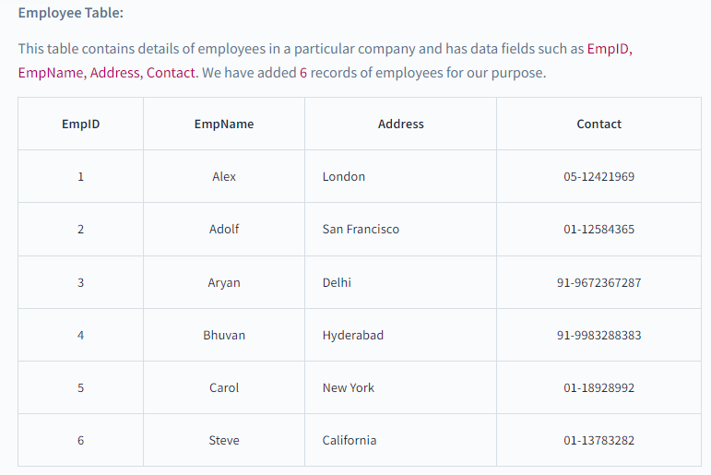
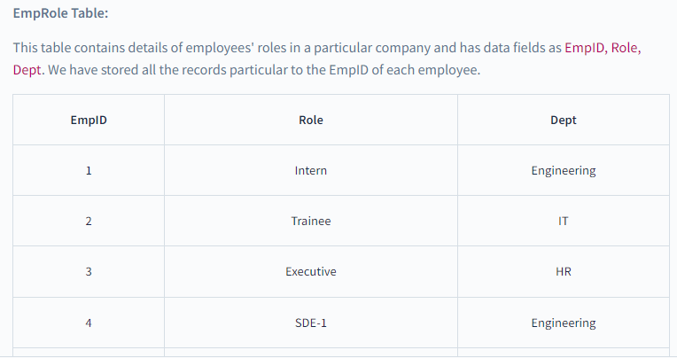
Creating a view

Slide 6
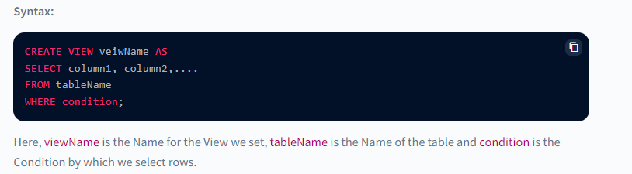
Creating a view cont..
The view can be created by using the CREATE VIEW statement, Views can be simple or complex depending on their usage.

Slide 7
Simple View (Updateable)
Simple view is the view that is made from a single table, It takes only one table and just the conditions.
It also does not take any inbuilt SQL functions like AVG(), MIN(), MAX() etc, or GROUP BY clause.
While creating a simple view, we are not creating an actual table, we are just projecting the data from the original table to create a view table.
Let's look at some examples for creating a simple view.
Example : In this example, we are creating a view table from Student Table for getting the StudentId, Name and Age. So the query will be :
CREATE VIEW Student_View AS
SELECT StudentID, Name, Age
FROM Students;

Slide 8
Complex View (Non Updatable)
The complex view is the view that is made from multiple tables.
It takes multiple tables in which data is accessed using joins or cross products.
It contains inbuilt SQL functions like AVG(), MIN(), MAX() etc, or GROUP BY clause.
So, whenever we need to access data from multiple tables we can make use of Complex Views.

Slide 9
Creating a Complex View cont..
CREATE VIEW Sales_Summary AS
SELECT ProductID, SUM(SalesAmount) AS TotalSales
FROM Sales
GROUP BY ProductID;
Reason for Non-Updatability:
The SUM function aggregates data, and there is no one-to-one mapping between the view rows and the base table rows.

Slide 10
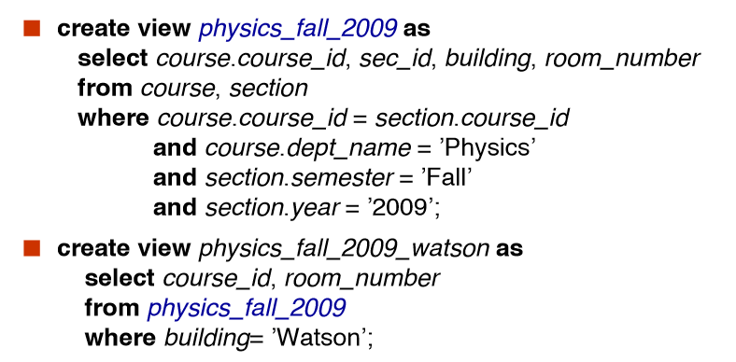
Views Defined Using Other Views

Slide 11
Why Are Complex Views Usually Non-Updatable?
Ambiguity in Mapping to Base Tables:
If a view combines multiple tables using joins, the system cannot determine which table to update when data is modified through the view.
Derived or Computed Columns:
Views with columns calculated using expressions (e.g., Salary * 12) cannot be updated because these columns don't directly exist in the base table.
Aggregate Functions:
Views with aggregate functions (e.g., SUM, AVG, COUNT) summarize data and cannot be mapped back to individual rows for updates.
GROUP BY or DISTINCT Clauses:
These operations collapse rows into groups, making it impossible to identify individual rows in the base table to update

Slide 12
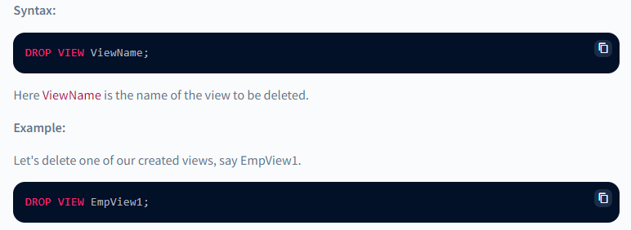
Deleting View
Now we know how to create simple and complex views but what if we don't need our created views anymore.
So we need to delete the view so as we DROP a table in SQL, similarly, we can delete or drop a view using the DROP statement.
The DROP statement completely deletes the structure of the view.

Slide 13
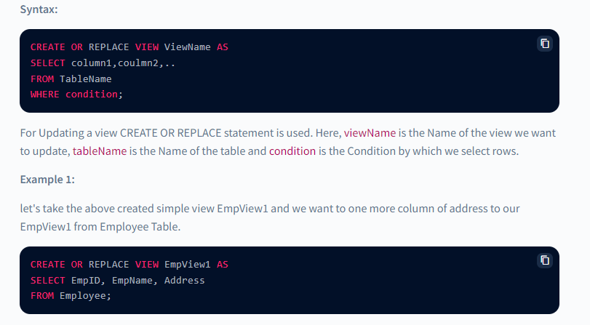
Updating View
Suppose we want to add more columns to the created view so we will have to update the view.
For updating the views we can use CREATE OR REPLACE VIEW statement, new columns will replace or get added to the view.

Slide 14
Manipulating Data in a View
Views can also be used to manipulate data in the scope of the view table only, manipulating data in a view does not affect the data of the original table.
Updateable Views are views that allow for data manipulation but there are certain conditions needed to be taken care of while manipulating the data of the view:
The GROUP BY and ORDER BY clauses should not be included in the SELECT statement used to generate the view.
The DISTINCT keyword should not be used in the SELECT statement.
All NOT NULL values should be present in the View.
Nested or complex queries should not be used to construct the view.
A single table should be used to generate the view. We will not be able to update the view if it was constructed using several tables.

Slide 15
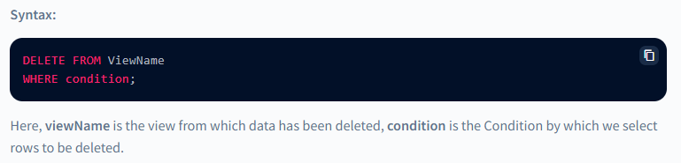
Deleting Row in a View
Deleting a row in the view takes the same syntax as we use to delete a row in a simple table.

Slide 16
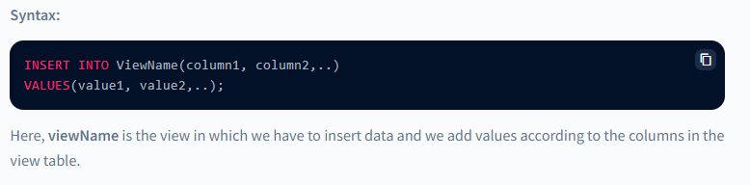
Inserting a Row in a View
Inserting a row in the view takes the same syntax as we use to insert a row in a simple table.

Slide 17
Thank You

